Slide 1


APP DATA ANALYSIS
GROUP MEMBERS
Deepanshi
Shivansh
Karthik
shanila

Slide 2
PROBLEM STATEMENT
We have gathered the data from the google play store apps. There are different categories there ,out of it randomly we selected 5 data and analysed. There are following columns:
App name
App category
App rating
App reviews
No. of App intalls

Slide 3
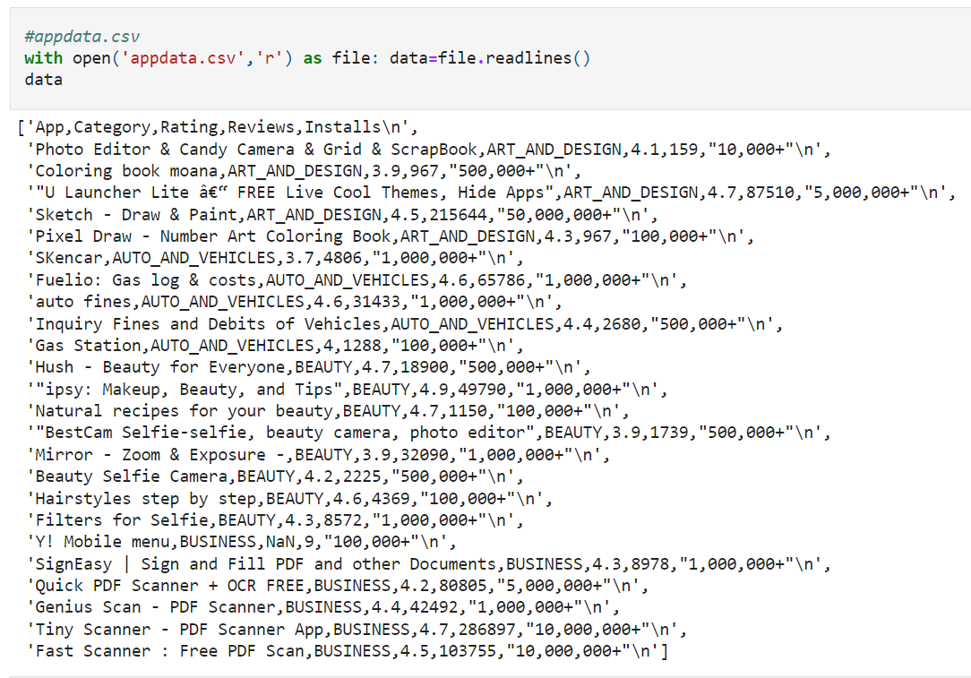
1. Imported csv excel file to python and using file reader ,read the file.

Slide 4
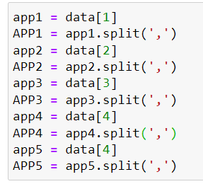

2. Splitting the data in multiple lists.
OUTPUT:

Slide 5




3. Maximum rating function on ratings list.
4. Minimum rating function on ratings list.

Slide 6
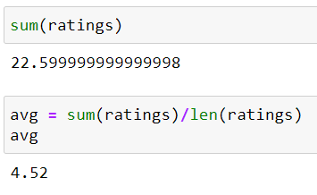
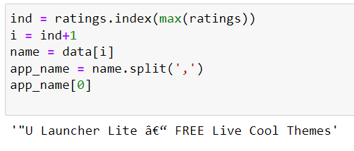
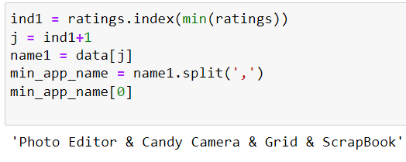
5. Sum and Average of App ratings.
6. Name of the app which having maximum and minimum rating.

Slide 7
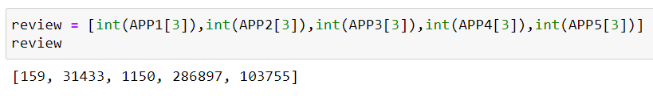
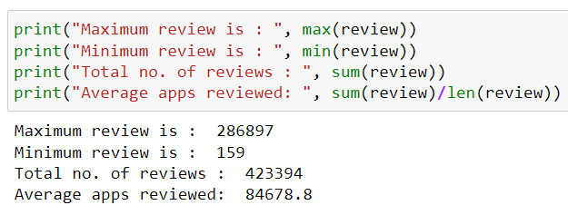
7. Reading number of Reviews on each app from dataset.
8. Maximum and minimum no. of reviews of app, Total and Average reviews given by users on all apps,

